Slide 1
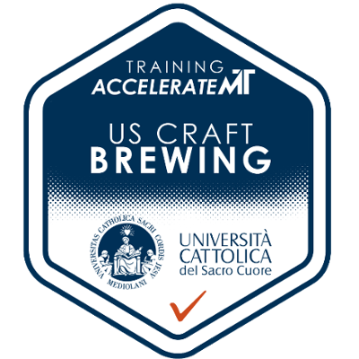

U.S Craft Brewing
Innovations in Business Models
Experiential Training Course for Università Cattolica del Sacro Cuore
October 2025

Slide 2
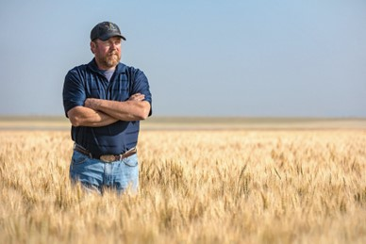
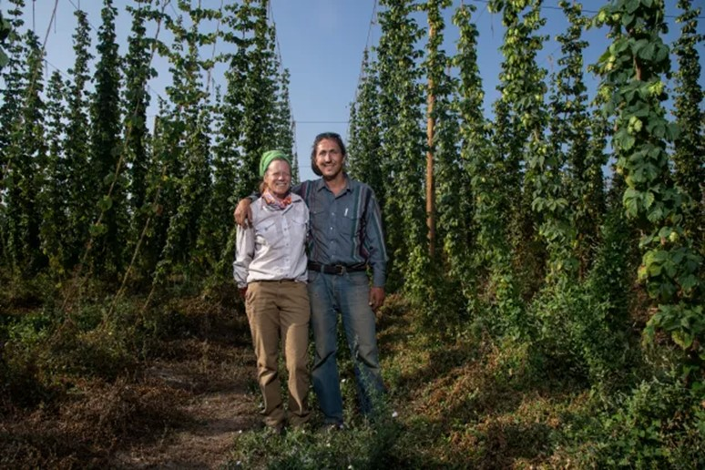
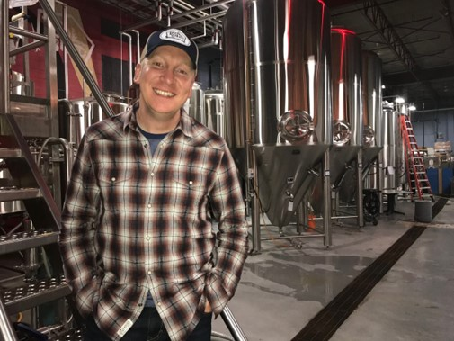
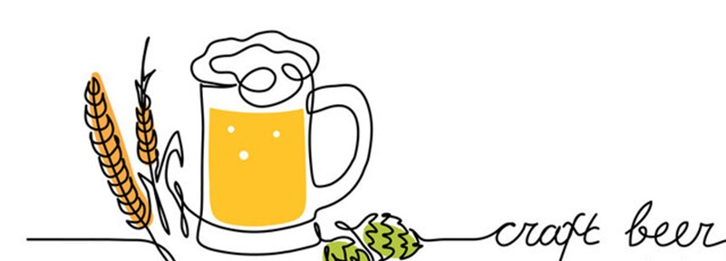
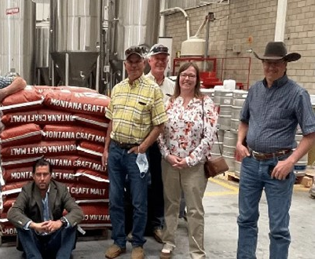

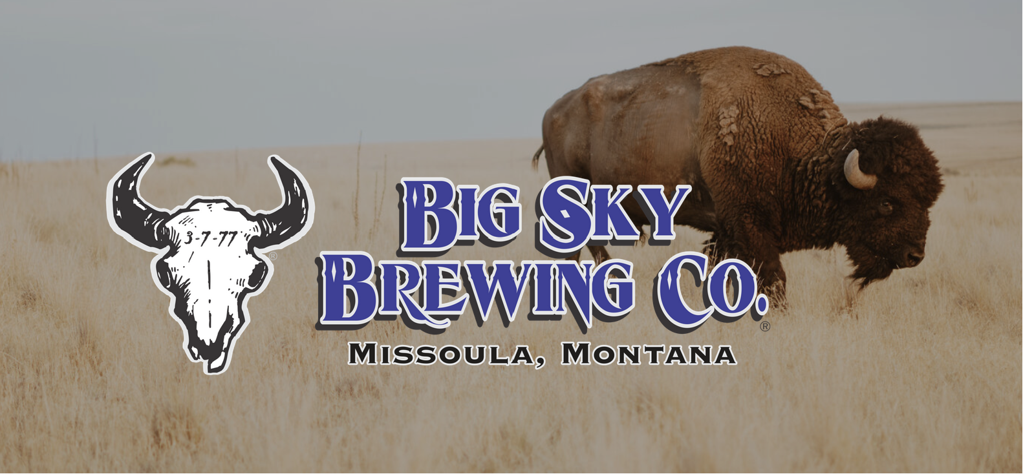
Overview
Introduction to Craft Brew 2026
Learning Objectives
Why Beer, why Montana?
Trip Itinerary
Digital Badge
Join Us!

Slide 3



The Partnership

Slide 4
Learning Objectives
Gain a deep understanding of business model design via the U.S. craft beer business, its innovations, its participants, and the ecosystem necessary to bring product to market.
Analyze contributors (e.g., barley farmers, hops producers, equipment manufacturers, etc.) and the value they create in the craft beer industry.
Learn about product, process and business model approaches in a highly competitive marketplace.
Understand regulatory restrictions (e.g., three-tier system) to bringing product to market, state-by-state expansion challenges, and import-export and opportunities.

Slide 5
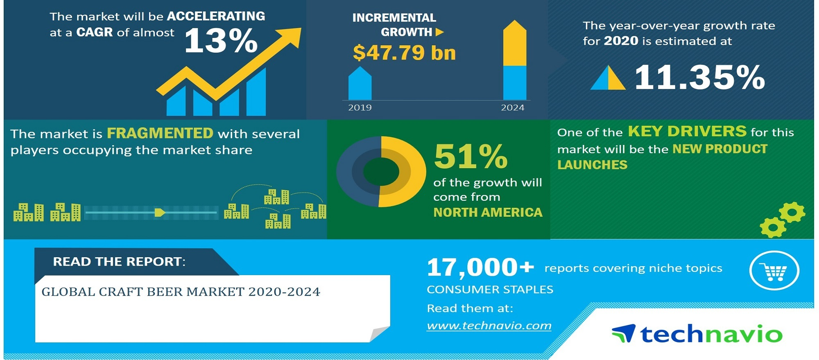
A Thriving Global Industry

Slide 6
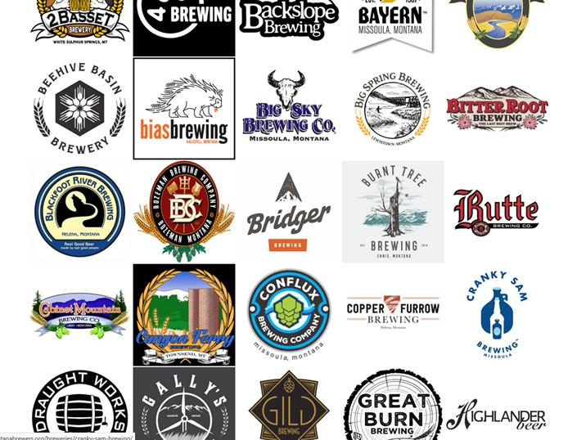
Why Montana?
Known worldwide for its beer product and process innovations.
One of the most concentrated geographic areas for craft breweries
  Over 100 breweries
Regional access to key input producers: barley, hops, yeast, etc.
Access to distributors, retailers (on-premise and off-premise), marketers, industry associations, etc.
Research centers focused on beer:
  University of Montana
  Montana State University

Slide 7
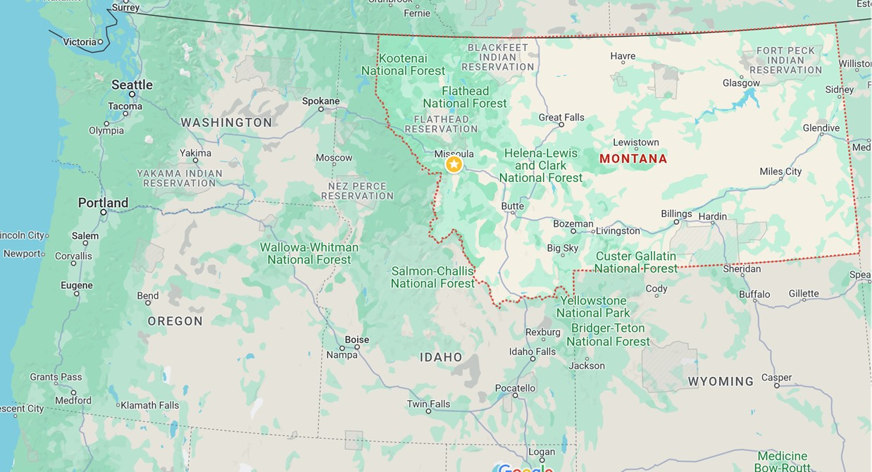
Where is Montana?
Where is Missoula?

Slide 8
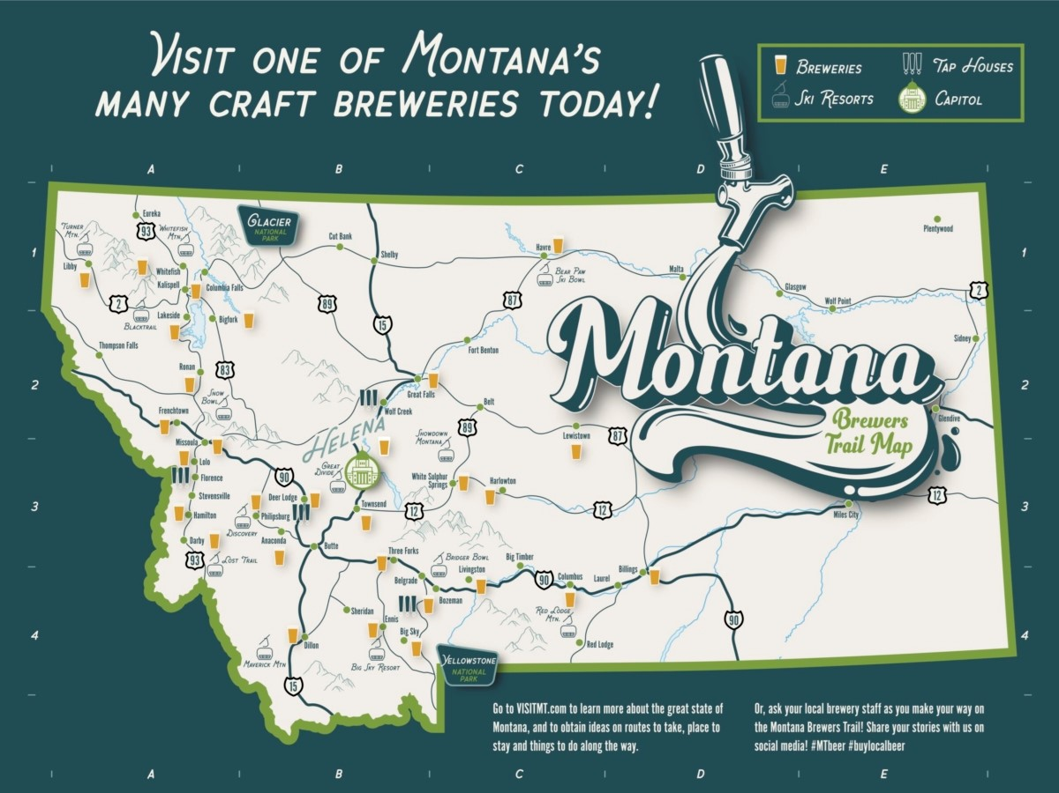

Slide 9

Trip Itinerary (subject to confirmation)
28/8: Arrival in Missoula – Move-in + Orientation; Group Dinner
29/8: Missoula – Campus & City Tour; Expectations, Participations and Project Deliverables
30/8: Missoula - Chris Palmer, UM + John Sanden, Sierra Nevada; Big Sky Brewing tour
31/8: Butte – Barley Growers Association + Headframe Distillery + Butte Historic City tour.
1/9: Missoula – Brewery Treasure Hunt + Business Model Presentations
2/9Flathead Lake – Flathead Valley Hops + Whistling Andy Distillery (Bigfork)
3/9: Arnie Sherman – International Business & Trade; Final Project Presentations
4/9: Missoula Farmer’s Market; Debrief; Wrap-up Dinner
5/9: Departure

Slide 10
Digital Badge Certification
Upon successful completion of training, participants receive a digital badge for their participation in the US Craft Brewing training.
Digital badges can be showcased in participants’ email signatures or on social media.
Employers, institutions, etc., can view meta-data related to badge:
  Tasks accomplished
  Skills & competencies achieved
  Assessments completed

Slide 11
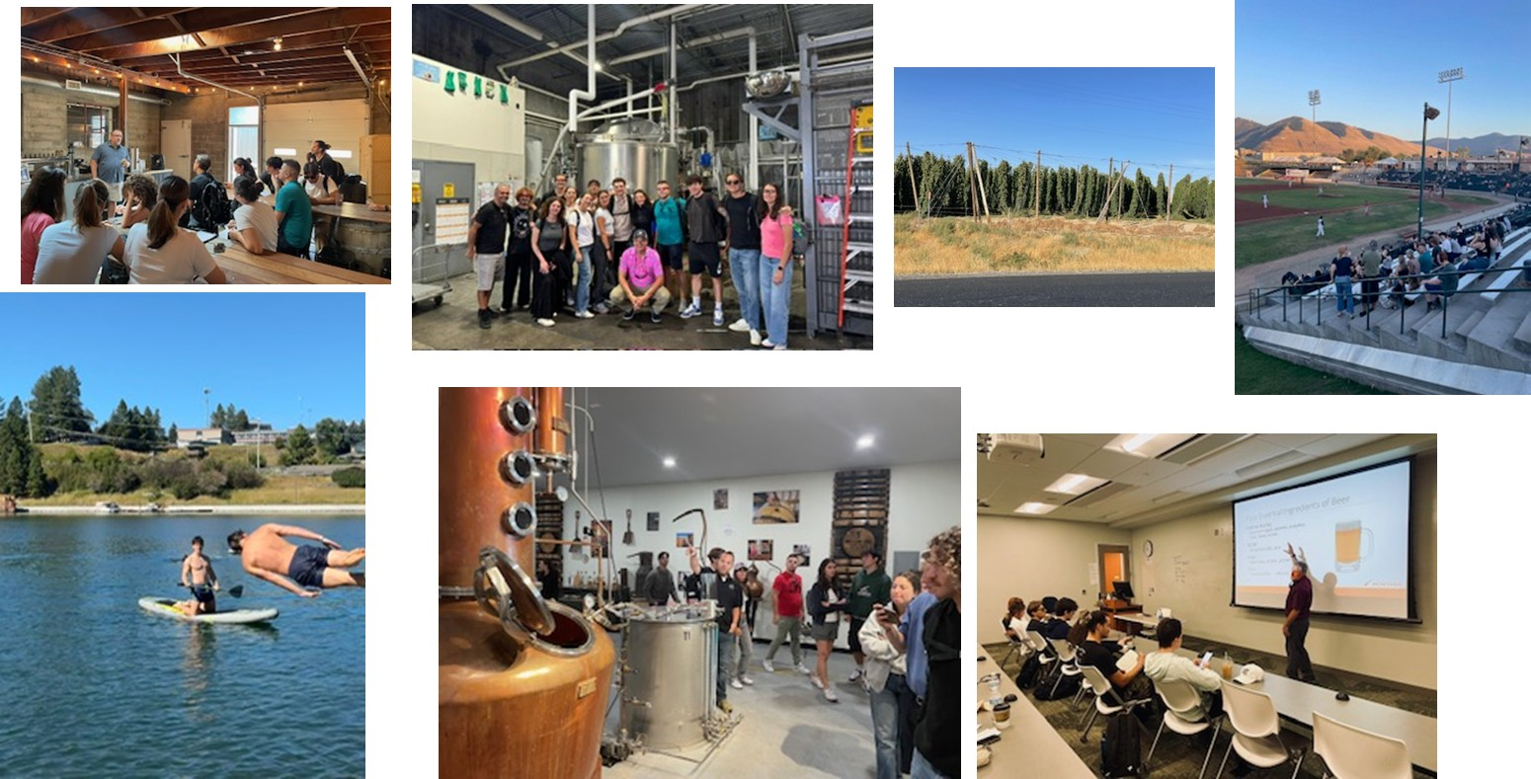

Slide 12
